Slide 1
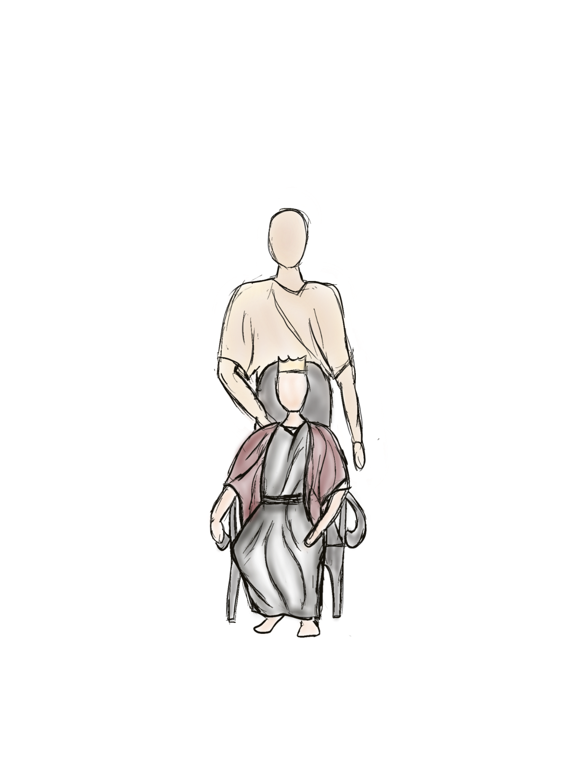
KING DAVID
- The Story of a King -

Slide 2
- A LITTLE SHEPHERD BOY -
Around 1000 BC, David, a little shepherd boy, was with his sheep in the fields.
Meanwhile Samuel, a prophet of God, gets the order to go to the Bethlehemite Jesse. God had chosen a new King among his sons as the current king Saul had lost the favor of God.

Slide 3
- A LITTLE SHEPHERD BOY -
Samuel did what the Lord commanded and came to Bethlehem. There Jesse showed him his seven stronger and older sons but the Lord had not chosen one of them. But Jesse had another son, David, a little shepherd boy. He was the one the Lord had chosen, because the Lord looks on the heart and not on the outward appearance.

Slide 4
- GODS FAVOR: DAVID THE ANOINTED KING -
Then Samuel took the horn of oil and anointed David in the midst of his brothers. And the Spirit of the Lord rushed upon David from that day forward.

Slide 5
- KING SAUL -
King Saul had lost the favor of God and a harmful spirit of the Lord came over Saul.
He searched for a musician to calm him and so David, a brilliant musician, came to Saul and entered his service. Saul loved David greatly, and he became his armor-bearer. And whenever the harmful spirit from God was upon Saul, David took the lyre and played it with his hand.

Slide 6
- WAR AGAINST THE PHILISTINES -
The Philistines gathered their armies for battle, and Saul and the men of Israel drew up a line of battle. The Philistines were on one side of a mountain, and Israel was on the other side, with a valley between them.

Slide 7
- GOLIATH -
And there came out a champion from the Philistines named Goliath of Gath. His height was 2.8 meters and he was well-armed. For 40 days, he mocked Israel and their God and shouted:
„Choose a man of yours and send him down to me.If he is able to fight with me and kill me, then we will be your servants. But if I prevail against him and kill him, then you shall be our servants and serve us.”

Slide 8
- DAVID TRUSTED IN GOD -
David, still a young man, came to the battle lines to look after his brothers. And when he heard the shout of Goliath he said:
“For who is this Philistine, that he should defy the armies of the living God?”
And then he said:
“The Lord who delivered me from the paw of the lion and from the paw of the bear will deliver me out of the hand of this Philistine.”
And he went to fight Goliath.

Slide 9
- BATTLE SHOWDOWN -
David was only armed with his sling and his shepherd`s staff but the Lord was with him. And so he approached Goliath.
And David put his hand in his bag, took out a stone and slung it, striking the Philistine on his forehead. The stone sank into his forehead, and he fell face down to the ground.

Slide 10
- DAVID`S VICTORY -
…and so David killed Goliath through the power of God. The Philistines fled from the battlefield and the men of Israel pursued them.
This is how David brought the Victory for Israel and the men of Israel had A NEW HOPE.

Slide 11
- GOD`S FAVOUR -
In the following years, David evolved to a great warrior and military leader. God´sfFavour was upon him.

Slide 12
- JEWISH FESTIVITIES -
The Israelites loved David and they began to celebrate him.
“Saul has struck down his thousands, and David his ten thousands.”
They sang to one another in the streets. But King Saul was very angry, and a spirit of jealousy came over him.

Slide 13
- SAUL PURSUED DAVID -
And Saul tried to kill David and David had to flee from him. Saul pursued David for several years but was unsuccesful. David had the favour of God and many people helped him hide from Saul.

Slide 14
- SAUL DIED -
After some time, the Israelites were at war with the Philistines again. But God`s favour was not with Israel and many men lost their lives. Israel had lost the war, and they were forced to flee. In the final battle Saul, the King, killed himself and so Israel was left without a King.

Slide 15
- DAVID CROWNED KING -
This was when, after this long time, David was crowned King as God had promised to the little boy…

Slide 16
- A KING WHO PLEASED GOD -
…and David was a good King. He was a King who pleased God and who was loved by the people.
God´s favour was upon him and God blessed him abundantly.

Slide 17
- BATHSHEBA -
But one day, David was on the roof of his palace and looked over the city. On the roof of a house, he saw a beautiful young woman. David desired her and asked his servants who she was.
The girl was called Bathsheba and was married to a man called Uria.
David sent a messenger for her to bring her to the palace

Slide 18
- DAVID´S SINS -
…and David slept with her. But Bathsheba got pregnant and so David tried to hide it. He tried many things but nothing worked. And so he desperately decided that Uria must die.
He sent Uria to war and ordered that the other warriors retire in the battle and let Uria die.
And so David sinned several times against God. But God is righteous and so David was punished. He married Bathsheba but their first child died…

Slide 19
- GRACE -
…but God also is merciful and he loves to forgive. And as David regretted what he had done, God´s grace came upon him. God forgave David and his favour was upon him again.

Slide 20
- A MAN OF GOD -
Many other things happened to David in his life and he experienced God in many ways. David was called a man after the heart of God, and although he also has done bad things, God was merciful and blessed him.
„The Lord is gracious, and full of compassion; slow to anger, and of great mercy“ – David in Psalm 145, 8

Slide 21
KING DAVID

Slide 22
KING DAVID
Now available on:
www.musictoaid.com

